Slide 1

ePlan Webinar
February 2021
Presenters: Susannah Maley and Dr Hamed Olfat

Slide 2
Introduction
Welcome to the second ePlan Webinar in our series to engage with industry on our recent development with the Single CAD Format File (SCFF) and the CAD to ePlan Converter Tool
Our first webinar in this series was held in November 2020. If you missed that session or would like to revisit the presentation, a recording is available from:
  SPEAR > ePlan > News and Events > Forums

Slide 3
Agenda
Introduction
SCFF Validation Service
Understanding the validation errors
Uploading the SCFF in SPEAR
Using the SCFF in the CAD to ePlan Converter
CAD to ePlan Converter Tool
Update and demonstration
Question and Discussion
Conclusion
FPET Registration

Slide 4
Purpose of SCFF
Purpose of the Single CAD Format File (SCFF) is to promote the lodgment of digital cadastral survey data to facilitate:
      Improved efficiencies in the updating of Vicmap Property by supplementing PDF cadastral plans & surveys in SPEAR
      Creation of ePlan LandXML files by directly uploading the SCFF into a CAD to ePlan Converter tool

Slide 5
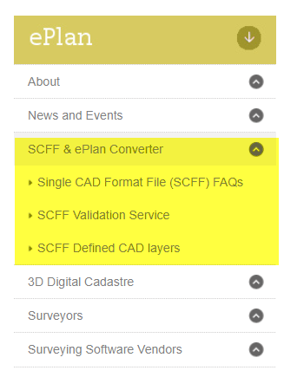
Online resources and SCFF Validation Service
The SPEAR website has been updated to include a section for
‘SCFF and ePlan Converter’
Go to SPEAR > ePlan > SCFF and ePlan Converter to view resources including:
SCFF Defined Layers
SCFF Validation Service
FAQ’s

Slide 6
Validation Rules
The SCFF validation rules are divided into five categories. Each category has one or more rules associated with it:
CAD-VR01 – Single CAD Format File Validity
CAD-VR02 – Geometrical Feature Existence in Standard CAD Layers
CAD-VR03 – Expected Feature Types
CAD-VR04 – Text Labels Required
CAD-VR05 – Naming Convention

Slide 7
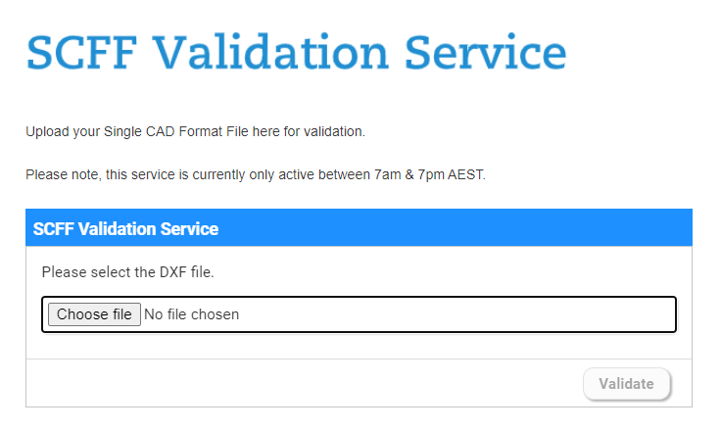
Validation Rules

Slide 8
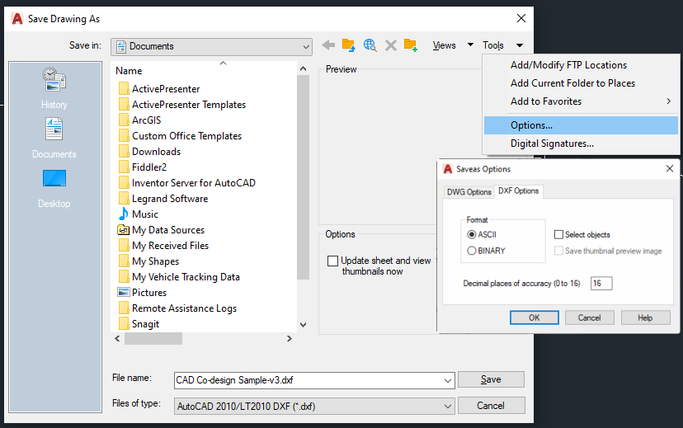
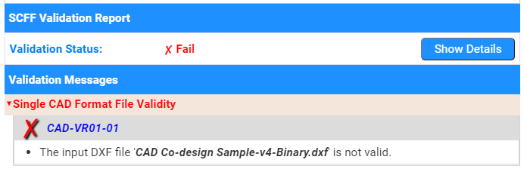
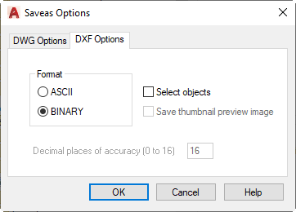
CAD-VR01: Single CAD Format File Validity
The DXF file will be deemed invalid if it has been corrupted, or the ‘save as’ options are different to those defined in the ‘SCFF guidance notes and instructions’
(VR01-01)

Slide 9
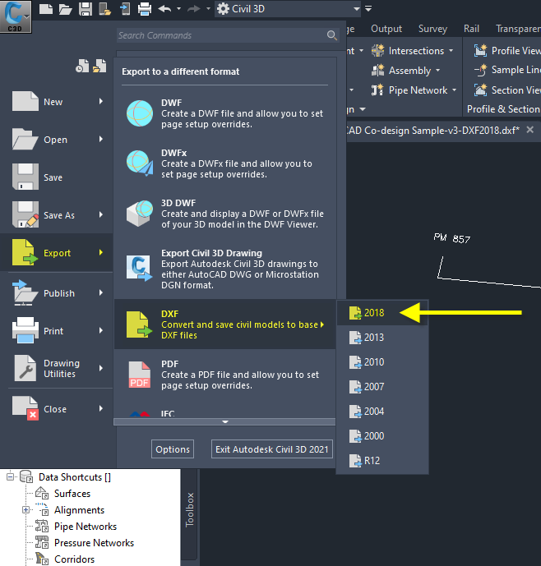
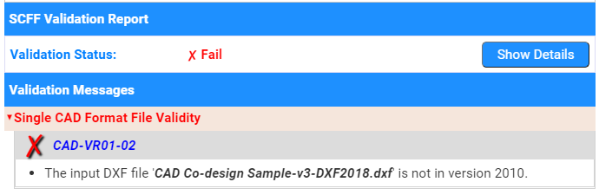
CAD-VR01: Single CAD Format File Validity
If the DXF file supplied IS NOT in ‘DXF version 2010’ an error will be displayed (VR01-02)

Slide 10
CAD-VR02 – Geometrical Feature Existence in Standard CAD Layers
The Validator will check to ensure that the standard CAD layers are being used. An error will be returned:
If there are no geometrical standard CAD layers in this file (VR02-01) or
If there are no feature(s) found in at least one of the standard geometrical CAD layers (VR02-02)

Slide 11
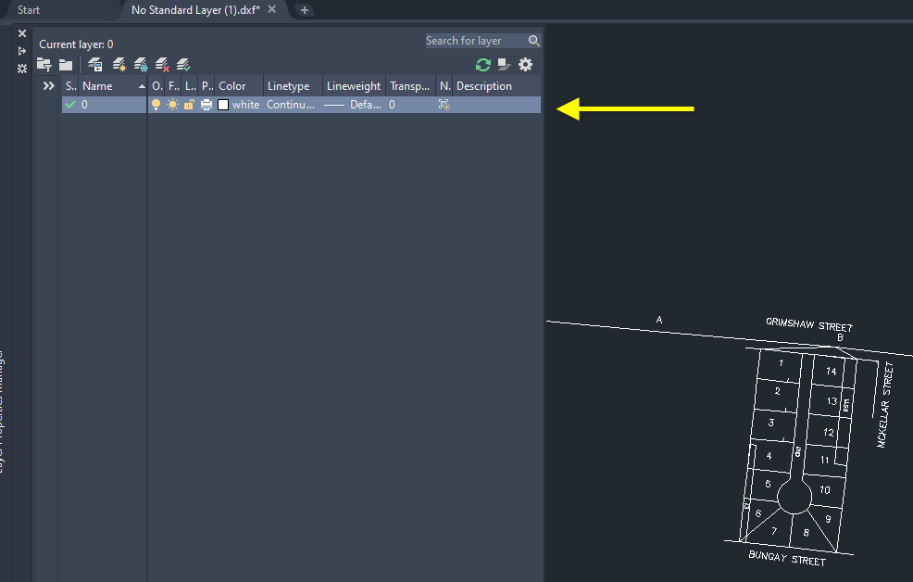
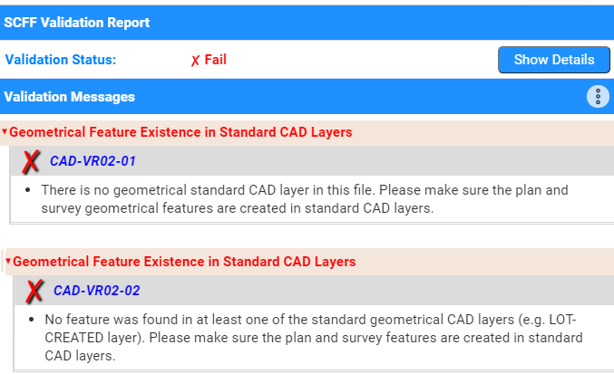
CAD-VR02 – Geometrical Feature Existence in Standard CAD Layers

Slide 12
CAD-VR03 – Expected Feature Types
The Validator will check to ensure that the layers all have the expected feature types (VR03-01)
For example:
In accordance with the SCFF layer specifications, the ‘Common-Property-Created’ layer is checked to ensure that only polygon features are used
Text labels, lines and unclosed polylines are not permitted within this layer

Slide 13
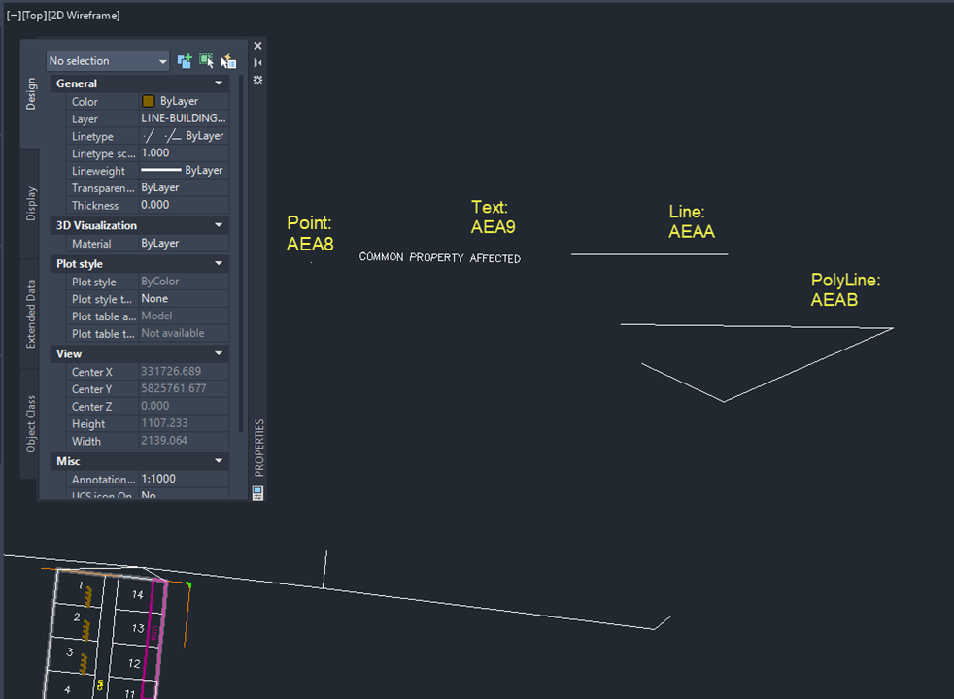
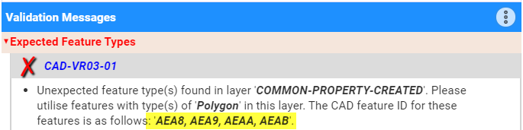
Text Labels Required

Slide 14
CAD-VR04 – Text Labels Required
A number of Text Label validations are in place to check that:
Each closed parcel has only one corresponding identifier label in its relevant text layer (VR04-01 and 02)
Where Easements overlap, the overlapping part must have only one corresponding identifier label in its relevant text layer (VR04-03)
Where Crown Land Services overlap, the overlapping part must have only one corresponding identifier label in its relevant text layer (VR04-04)
The insertion point (lower left corner) of PM/PCM nine figure number text should be positioned exactly on the PM/PCM point coordinates (VR04-05)
All PM/PCM have only one corresponding label (VR04-06)

Slide 15
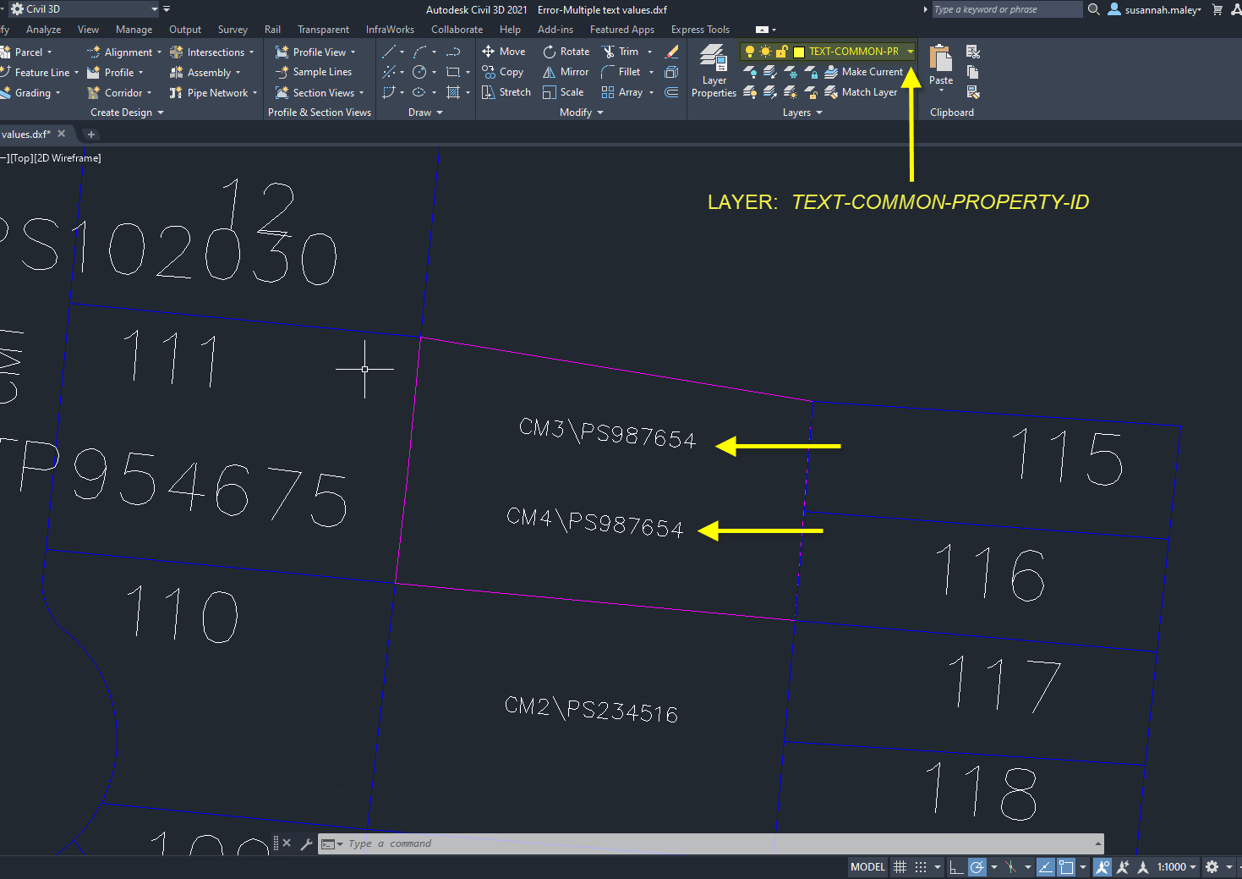
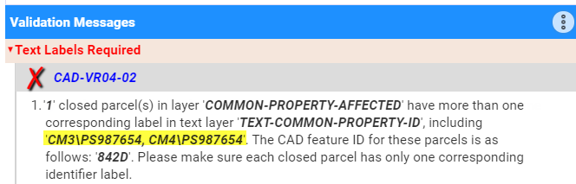
Validation Example

Slide 16
CAD-VR05 – Naming Convention
The final validation rule category checks that parcel identifiers follow the expected naming convention (VR05-01)
This validation rule applies to text layers 63 to 73
The naming conventions are all outlined in the ‘SCFF Defined CAD Layers’ document

Slide 17

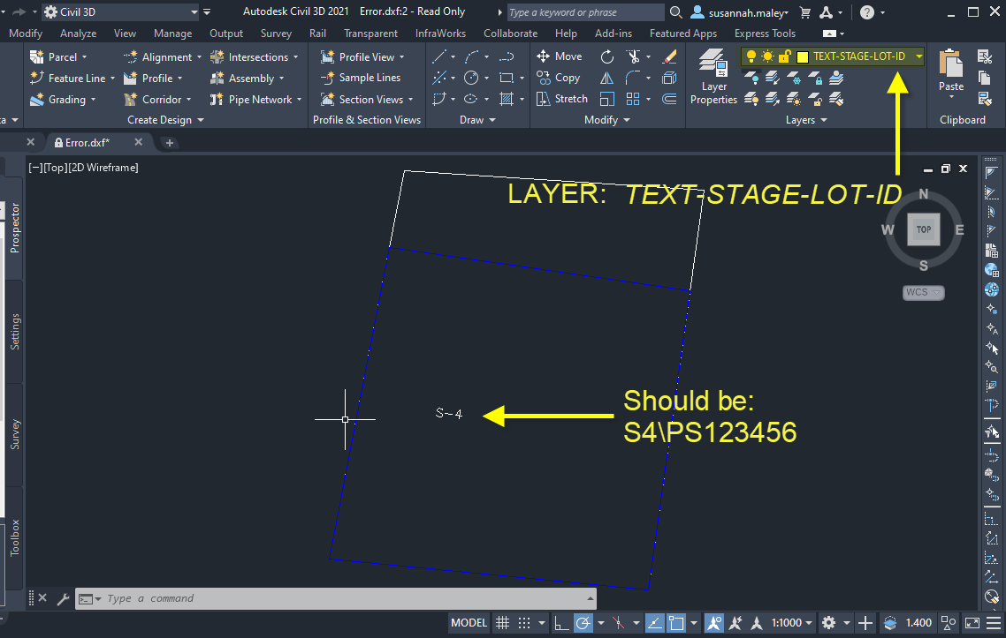
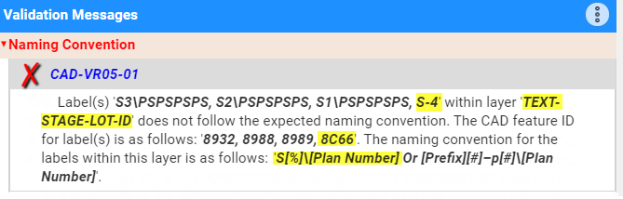
Example of Incorrect Naming Convention

Slide 18
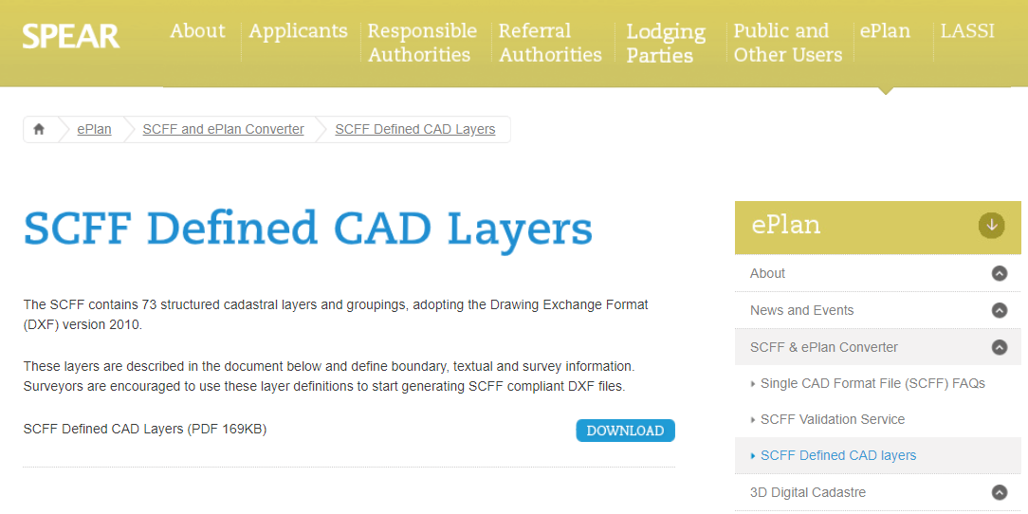
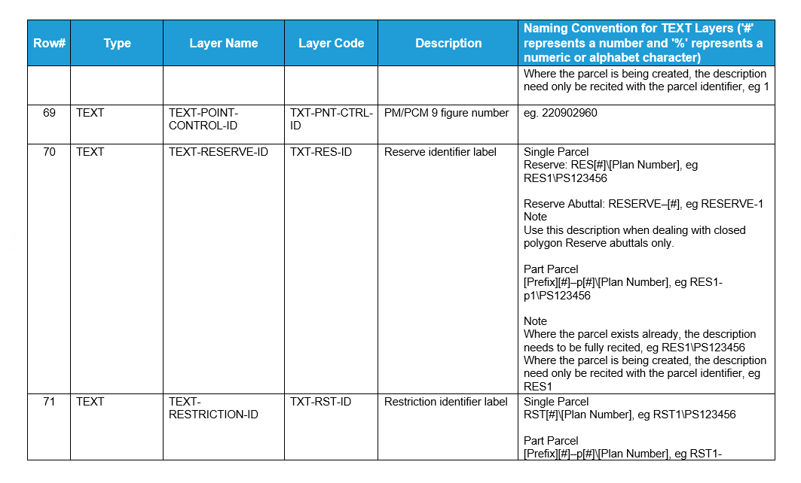
SCFF Defined CAD Layers document

Slide 19
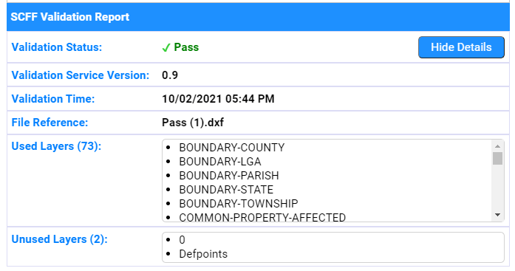
Validated DXF which is SCFF compliant

Slide 20
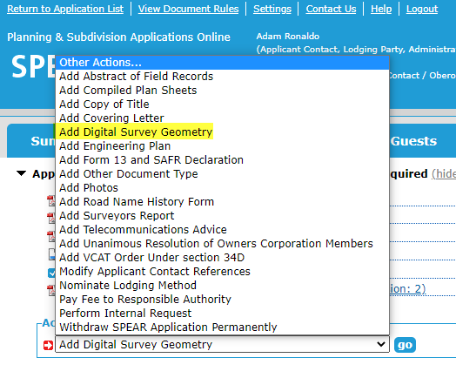
Supplying SCFF for PDF Plan Applications
For PDF plan applications:
Attach the SCFF into SPEAR by selecting ‘Add Digital Survey Geometry’ from the ‘other action’ drop-down list
‘Digital Survey Geometry’ is existing functionality in SPEAR

Slide 21
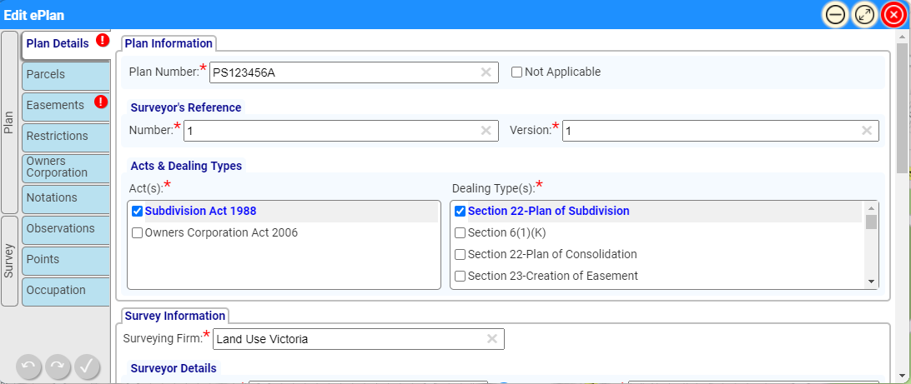
Supplying SCFF to the
CAD to ePlan Converter Tool
The SCFF is to support the creation of ePlan LandXML files
Surveyors will use the SCFF in the ‘CAD to ePlan Converter Tool’

Slide 22
CAD to ePlan Converter
Video demonstration of the CAD to ePlan Converter tool and recent development

Slide 23
Questions and discussion?

Slide 24
Conclusion
Next Steps
  SCFF resource materials continue being updated to the SPEAR website
  Transition to adopting the SCFF and utilising the CAD validation service
  Supplying DSG files in SCFF for new subdivision applications in SPEAR
  3rd ePlan webinar demonstrating the first release of the CAD to ePlan Converter
  Piloting the CAD to ePlan Converter
Need support?
  Contact the SPEAR service desk

Slide 25
Finally…..
Reminder to surveyors to register for their ‘1 Cadastral Survey Practice FPET point’, please do so by completing the webform that has been shared in the chat space
In completing the webform, we also ask you provide the CAD software you will be using in adopting the SCFF
https://tinyurl.com/1uh2vult

